Slide 1
Evaluating Model Performance in the Estimation of Health Effects from Complex Environmental Mixtures: A Simulation Study
Zachary Katz
April 2023

Slide 2

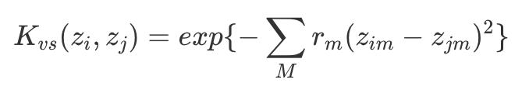
Quick Intro to BKMR
Flexible, non-parametric way to detect and estimate effects of individual exposures, groups of exposures, or an overall mixture on observed (health) effects
Can accommodate nonlinear and non-additive effects of multivariate exposure set
Models exposures through a kernel function, frequently Gaussian
Y = outcome, h = flexible function of predictors Z, X = covariate set
Kernel function shrinks estimated health effects of similar i (exposure profiles) towards each other, implicitly operating a variable selection procedure by allowing some weights to be 0
Prior information could be specified on the model parameters for Bayesian technique

Slide 3
Motivation
BKMR was originally published by Bobb & Valeri in 2015:
Generated 300 datasets of 100 observations each
Total mixture components: M = (3, 13)
One confounder
Health outcome dependent on a subset Q < M of available exposure variables, but not on a confounding covariate set
Performance unclear if confounders are included in the hinge function
As it turns out, almost all ML methods used in EHS for mixture studies have remained unchallenged in simulation studies by complex confounding structure
Lack of clarity in how methods perform in such contexts → which models to apply to the data?
Risk using sub-optimal techniques for effect estimation without proper evaluation in a controlled setting (and non-parametric techniques in particular may result in non-reproducible findings)
Objective:
Compare a variety of traditional and ML methods for evaluating individual exposure and overall mixture effects when complex relationships between exposures, confounders, and outcome are present

Slide 4
Selection of Statistical Methods
 | BKMR | BART | Quantile G-Computation | Elastic Net | Linear Regression | MARS | GAM | Causal Forest | Random Forest | Super Learner
Required
Continuous outcome | X | X | X | X | X | X | X | X | X | X
Multiple continuous exposures | X | X | X | X | X | X | X | X | X | X
Nonlinear and interaction effects on outcome | X | X | X | X | X | X | X | X | X | X
Inference (point estimates + CIs) | X | X | X | X | X | X | X | X | X | X
Automated functional form of covariates | X | X |  |  |  | X |  | X | X | X
Implementable in R | X | X | X | X | X | X | X | X | X | X
Preferred
Non- or semi-parametric | X | X |  |  |  | X | X | X | X | X
Variable selection | X | X |  | X |  | X |  |  |  | X
Popular in EHS mixture studies | X | X | X | X | X | X |  |  |  | X
Other methods evaluated: TMLE, WQS regression, LASSO, Ridge regression, BSTARSS, logistic regression, (Bayesian non-parametric) non-negative matrix factorization, (Bayesian) factor analysis, (Sparse) PLSR, Bagging, Boosting, PCA, cluster analysis, SVM, regression trees (CIT or CART)

Slide 5
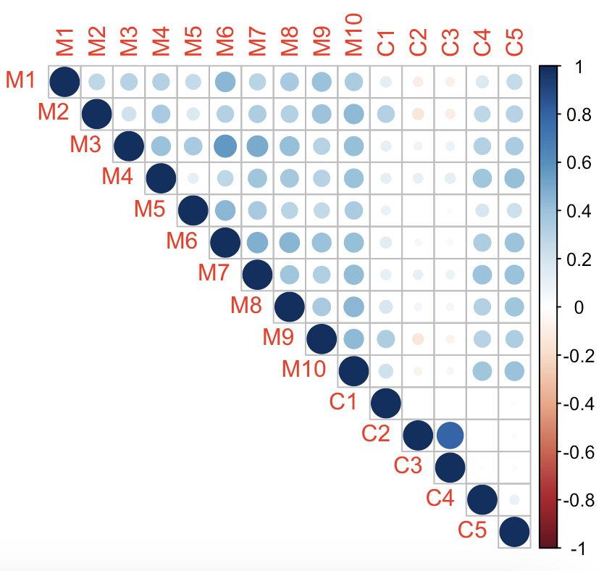
Simulation Study: Data Generation
Data generation:
2 scenarios with identical datasets except for specification of the outcome
200 datasets per scenario
10 exposures, 5 confounders, & 1 outcome
For exposures and confounders, closely mimic parameters from the Strong Heart Study (thanks Melanie!) & extend to increase dimensionality
Induce moderate multicollinearity & add noise for variation
Intra-exposure correlations generally ranging from 0.3 to 0.5
Exposure-confounder correlations vary widely, generally from -0.2 to 0.4

Slide 6
Simulation Study: Scenarios
Scenario #1:
Simple exposures (M1-M5 only)
Complex confounding (C1-C5)
Moderate multicollinearity
Scenario #2:
Confounders specified identically to Scenario #1
Only change is in how exposure set is specified in outcome’s functional form
Additional exposure-confounder interaction

Slide 7
Causal Estimand

